Slide 1
LDO(LINEAR REGULATOR)
SUITABLE FOR LOW-CURRENT APPLICATIONS
SIMPLE CIRCUIT DESIGN
GENERATES MORE HEAT (LOW EFFICIENCY)

Slide 2
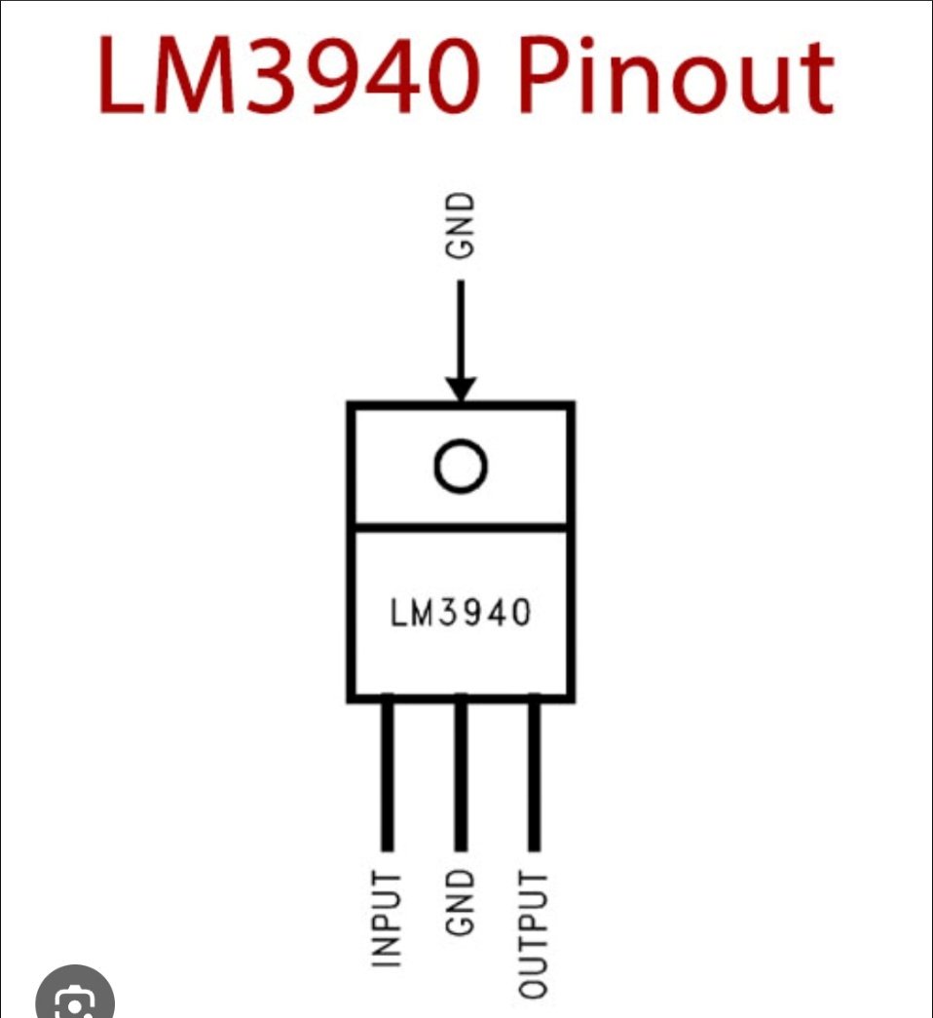
LM3940

Slide 3
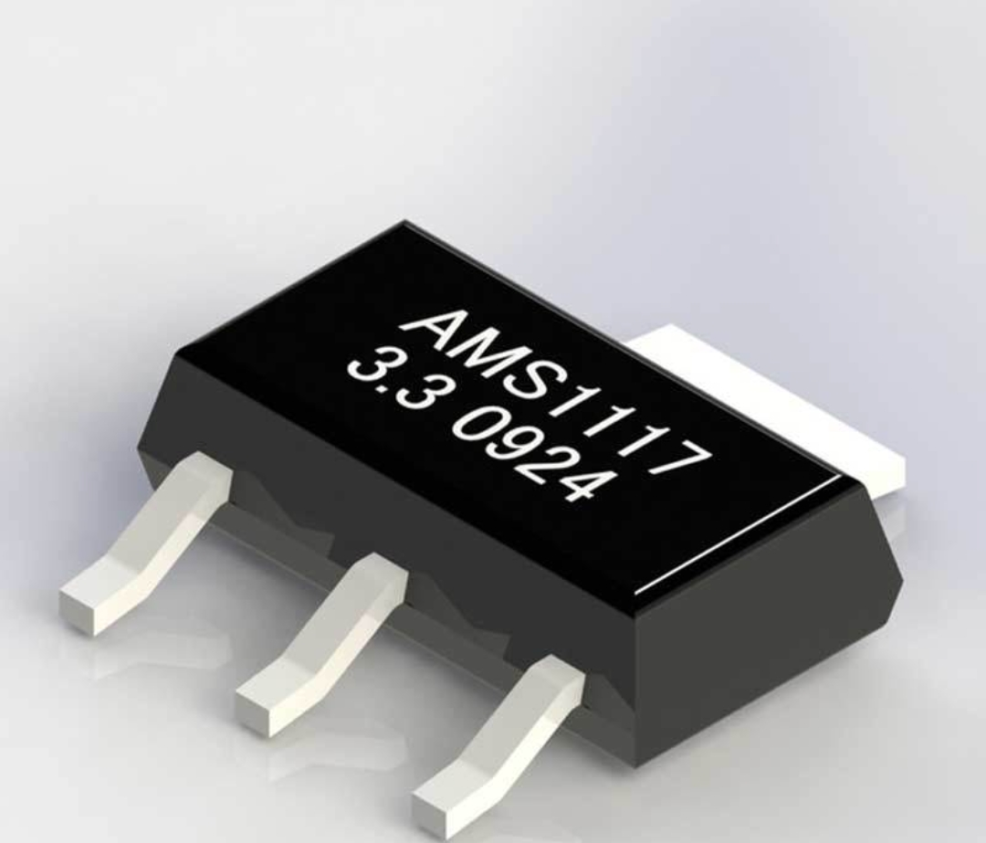
AMS1117-3.3

Slide 4
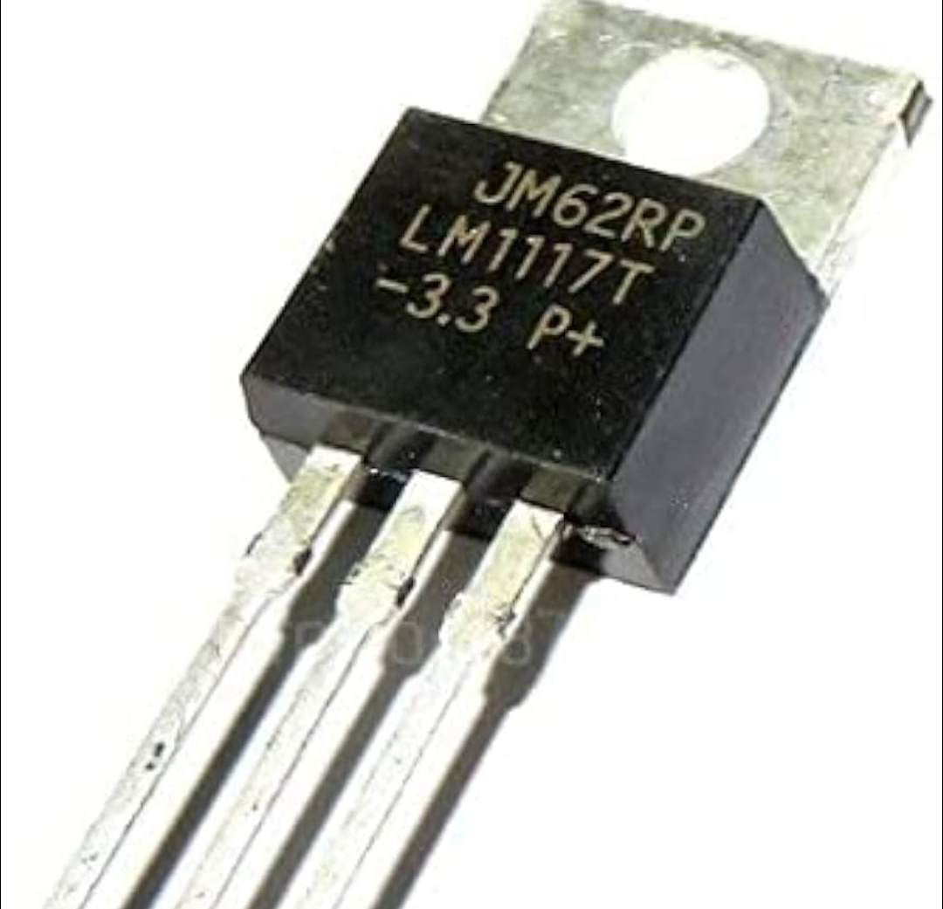
LM1117-3.3

Slide 5
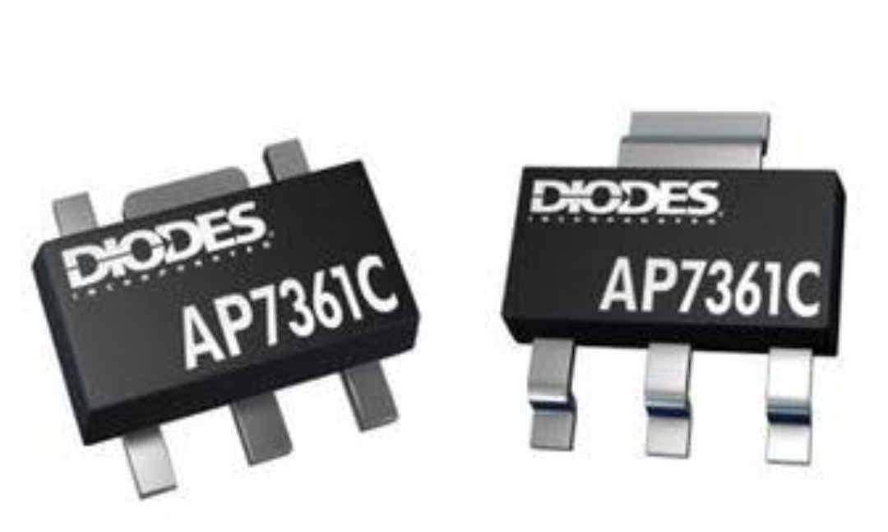
AP7361C

Slide 6
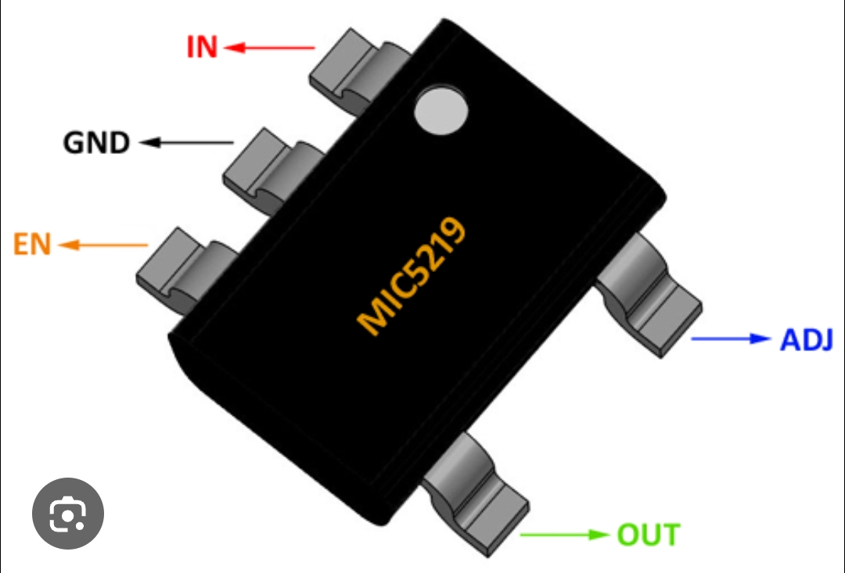
MIC5205/MIC5219

Slide 7
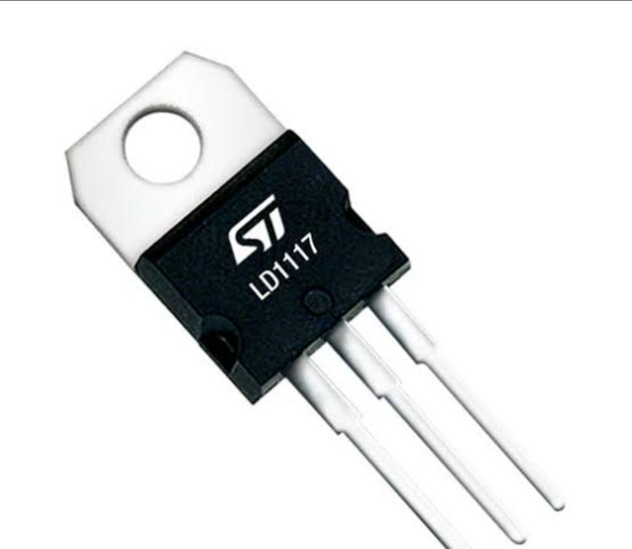
LD1117V33C

Slide 8
DC-DC BUCK CONVERTER (SWITCHING REGULATOR)
SUITABLE FOR HIGH-CURRENT AND HIGH EFFICIENCY APPLICATION
GENERATES VERY LITTLE HEAT

Slide 9
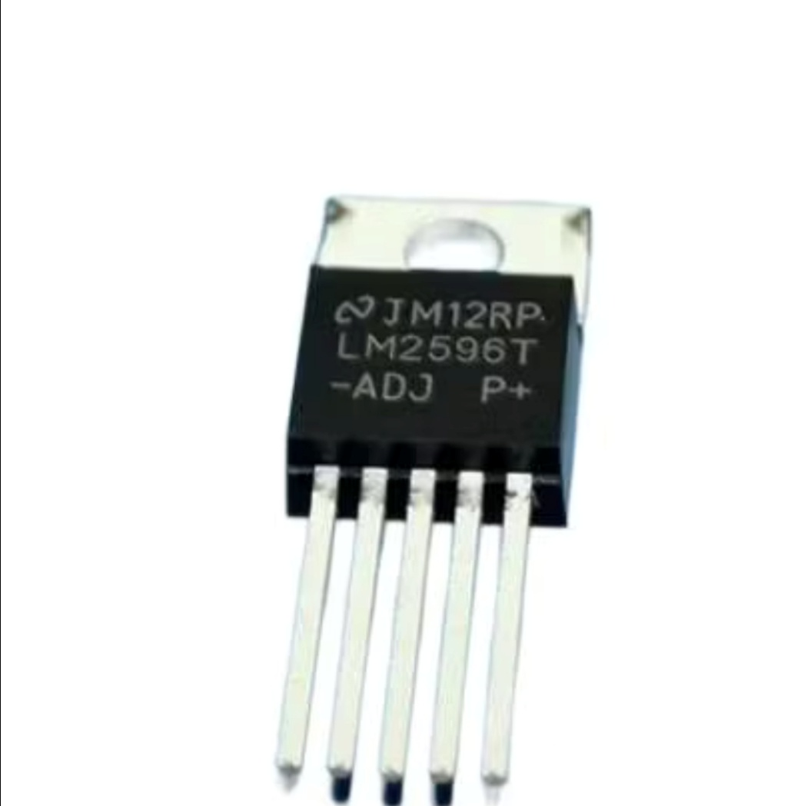
LM2596

Slide 10
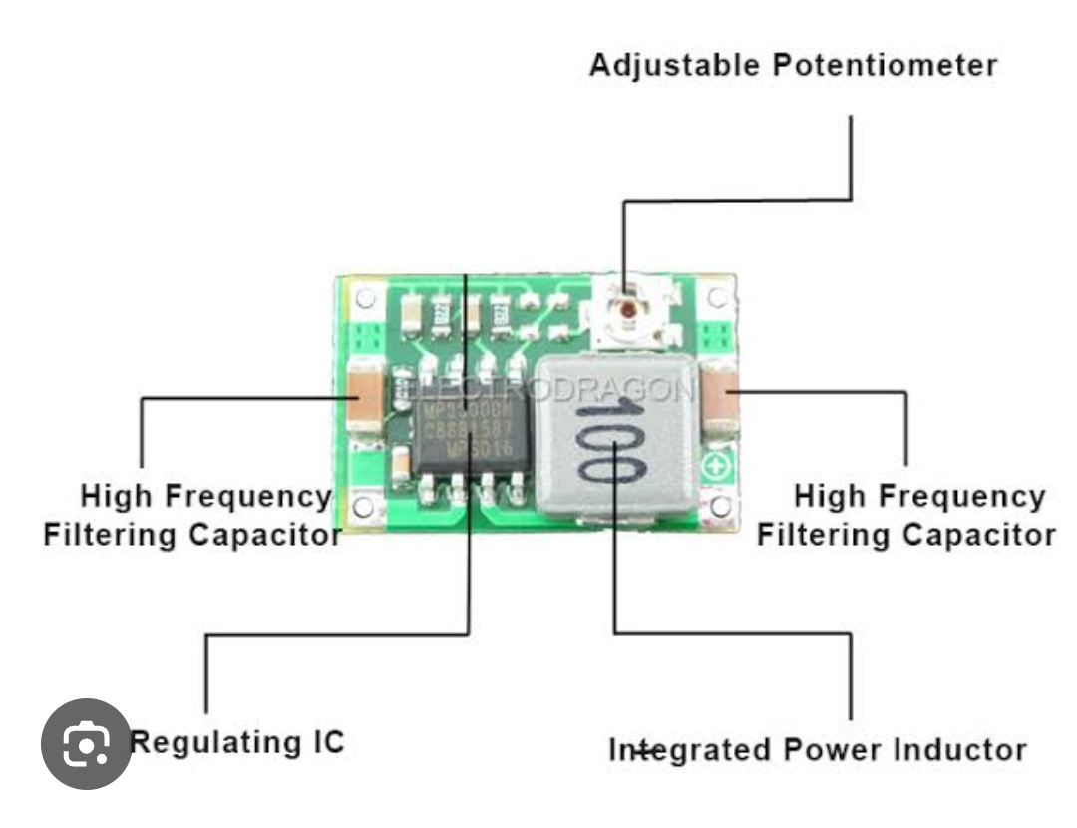
MP2307

Slide 11
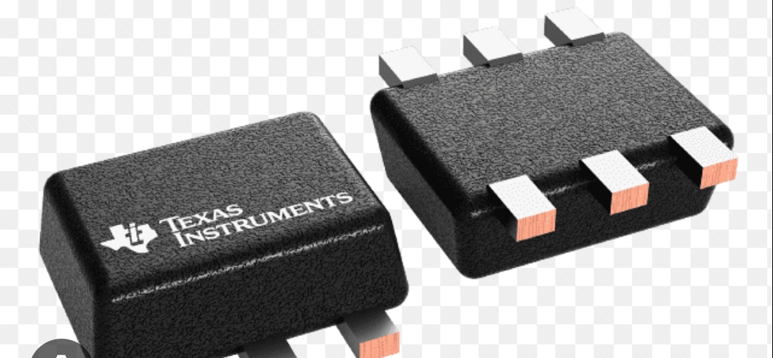
TPS62175

Slide 12
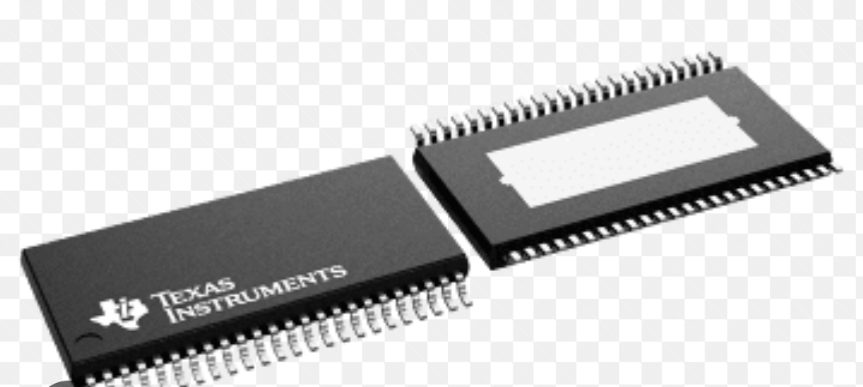
LM684X5-Q1

Slide 13
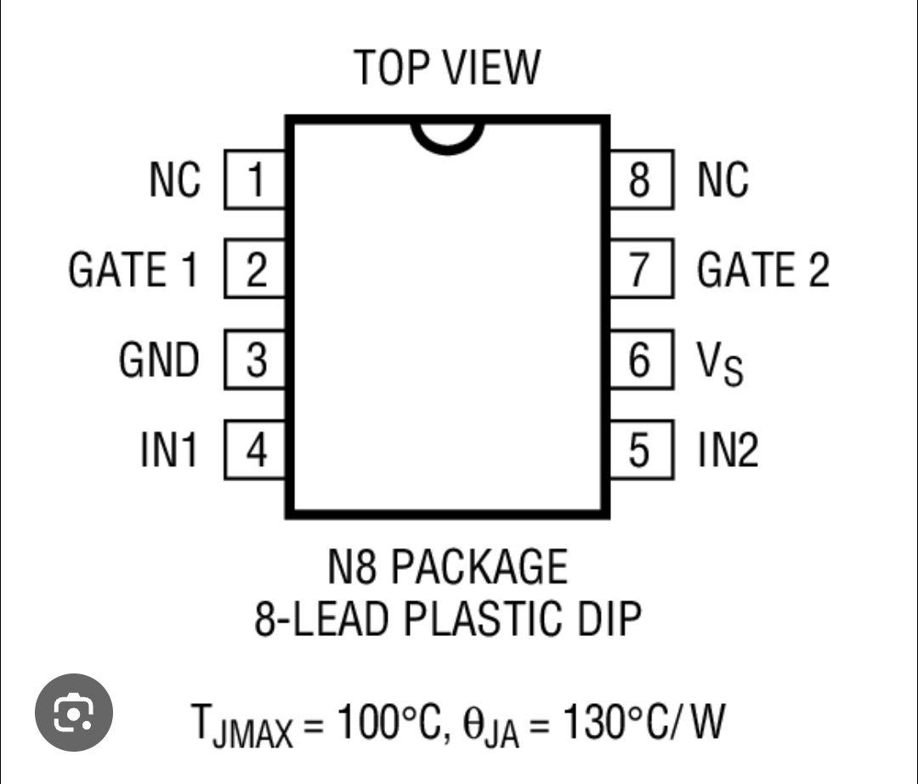
LTC1147-3.3

Slide 14
READY-MADE MODULES
THESE MODULES CAN BE USED DIRECTLY WITHOUT DESIGNING A VOLTAGE REGULATOR CIRCUIT

Slide 15
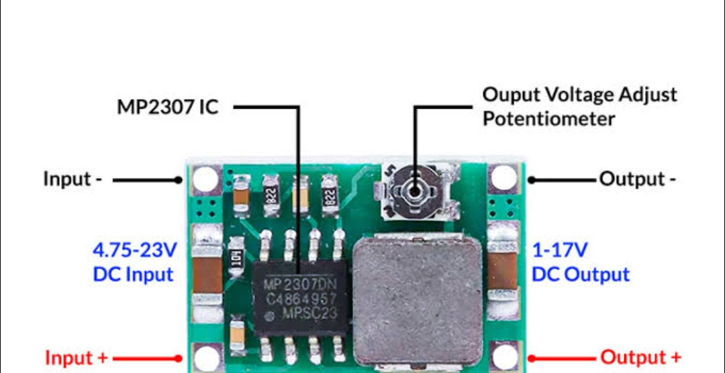
MINI -360 BUCK CONVERTER

Slide 16
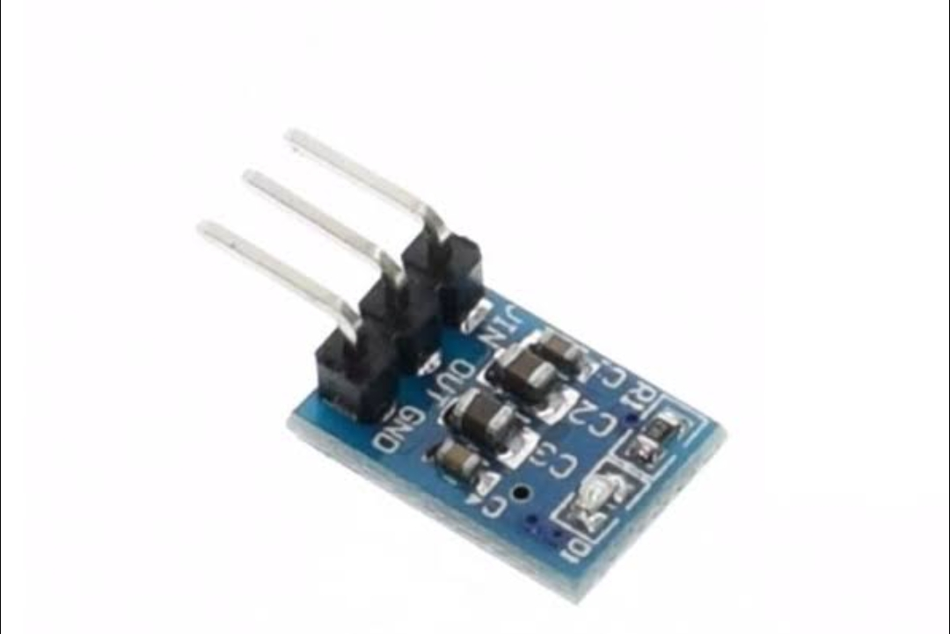
AMS1117-3.3 MODULE

Slide 17
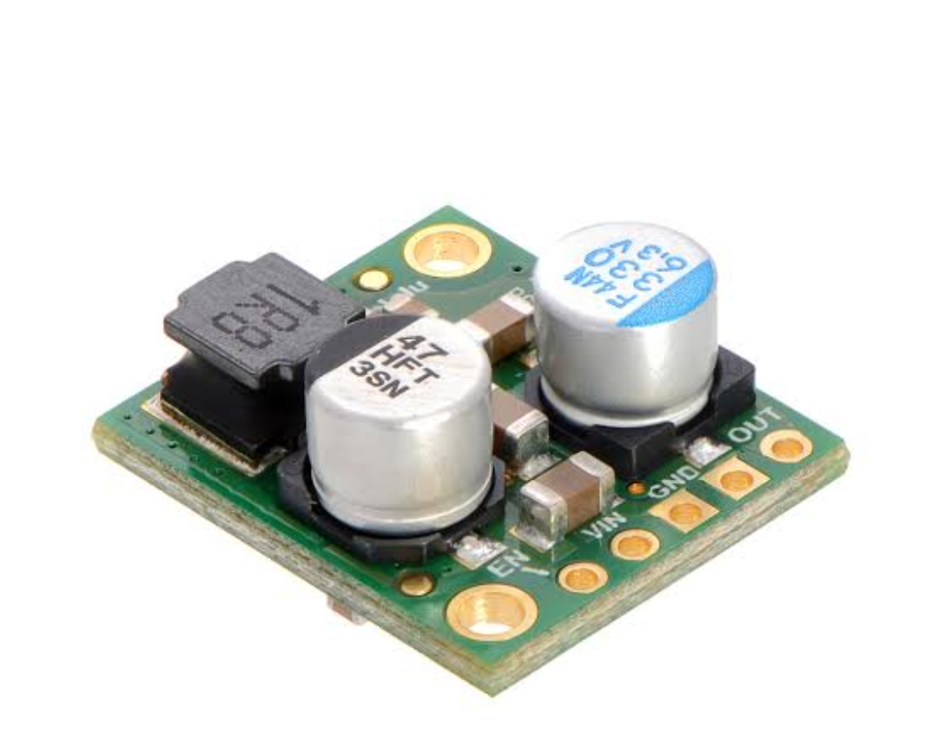
POLOLU STEP-DOWN REGULATOR MODULE

